Slide 1

教学辅助课件
牛津 七年级下

Slide 2

Unit 5 Amazing things
Integrated skills

Slide 3




Words & phrases review
snake
camel
ant
little
dry
without
be afraid of
n. 蛇
n. 骆驼
n. 蚂蚁
pron. & det. 不多的, 少数的
adj. 干的; 干燥的
prep. 没有
害怕
Read after the tape and speak out the Chinese immediately.

Slide 4
Words & phrases review
not … any more
hear of
the other day
at the same time
3-D
chalk
再也不, 不再
听说, 知道
那天, 前几天
同时
n. (=three-D) 三维, 立体
n. 粉笔

Slide 5

To listen and learn about giraffes, snakes, camels and ants
To learn to talk about some amazing things you know
To learn the new words and useful expressions

Slide 6

Focus on
Words:
snake ant little dry
without chalk camel 3-D
Expressions:
live without water know more about
be afraid of not … any more
hear of the other day
write with one hand at the same time

Slide 7
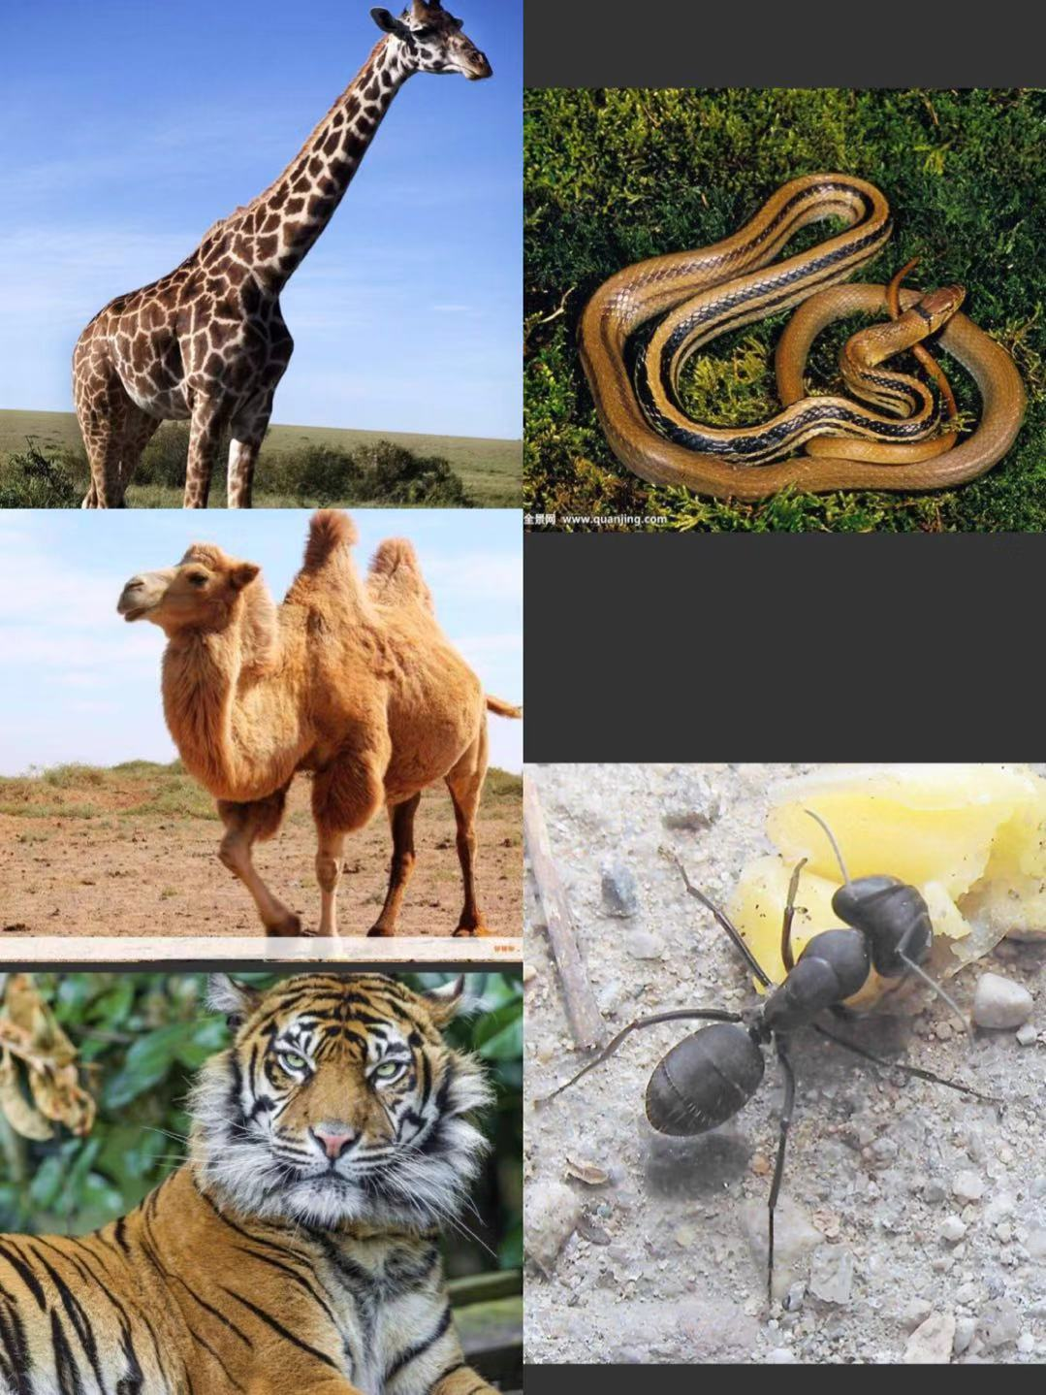

Guess the animals as quickly as possible!
a giraffe
a snake
a camel
a tiger
an ant

Slide 8
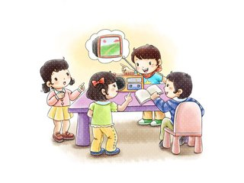
Pair work
tigers
How much do you know about these animals?
2. What animals are you fond of?
3. What animals are you afraid of?
giraffes
ants
camels
snakes
Discuss with your partners and show your answers.

Slide 9

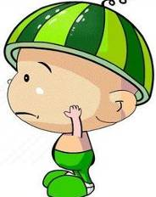
Mr Wu is showing some pictures of animals. What animals is he showing? Listen to their conversation and get the answer.
Mr Wu is showing a giraffe, a snake, camels and ants.

Slide 10
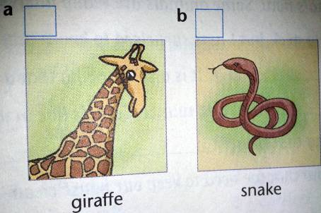
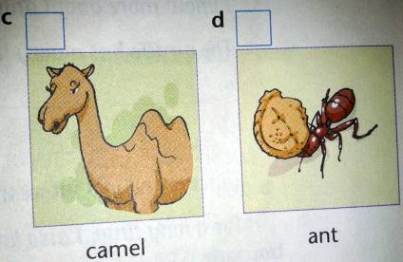
Put the pictures in the correct order. (P 63)
A1
1
3
4
2

Slide 11
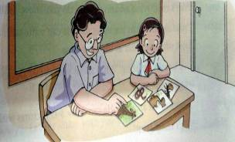

1. How many bones does a giraffe have
in its long neck?
2. What do snakes do in winter?
3. How long can camels live without water?
4. What are ants good at?
There are only seven bones in it.
Suzy is afraid of animals. Mr Wu wants to help her. He is telling her some interesting things about animals. Listen to their conversation and answer the questions.
They sleep all the time and eat little or nothing in winter.
They can live for a long time.
They smell things well.

Slide 12
a giraffe — has a very long neck
only _____ bones in its
long neck
a snake — lives on the ground, in trees
or in water
eats little or nothing for
_______ in cold winter
camels — live in very dry places
can live without ______ for a
long time
ants — can ______ things well
seven
Listen to Suzy and Mr Wu’s conversation again and help Suzy complete her notes. (P 63)
A2
months
water
smell

Slide 13
Dear Mr Wu,
Thank you for your help.
I know more about animals now. Some animals are really interesting. The giraffe has a very long neck, but I was surprised to know that there are ______________ in it.
It is also amazing that a snake ____________
___________________ in cold winter. Camels live in very dry places, and it is interesting that they___________________ for a long time. I also know that we need to keep our house clean — ants ________ __________.
Now, I am not afraid of animals any more. I would like to learn more about them.
Suzy
A3
Suzy is not afraid of animals now. She is writing a thank-you letter to Mr Wu. Help her finish the letter. Use the notes in Part A2 on page 63 to help you. (P 64)
only seven bones
eats little or nothing for months
can live without water
can smell
things well

Slide 14


1. How did the young man travel around over 80 countries?
By bicycle.
Speak up: That's really amazing!
2. What can the man do with two hands at the same time?
The students are talking about amazing things in the world. Listen to the tape and then answer the questions.
He can write with one hand and draw with the other at the same time.
3. What amazing things does Peter know?
He learnt about an artist. He can draw 3-D pictures with chalk.

Slide 15
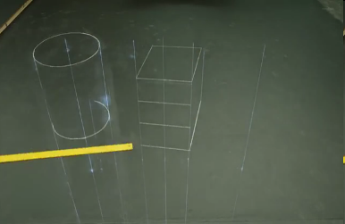

Watch the video.
What’s the artist doing in the video?
He is drawing a 3-D picture with chalks.
It is really amazing!

Slide 16
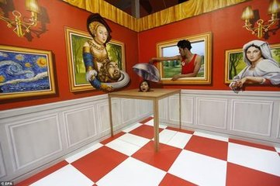
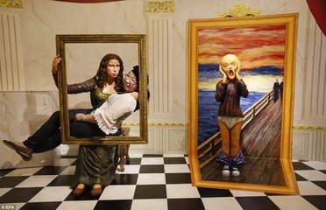
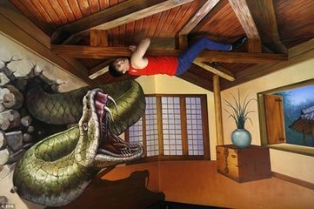
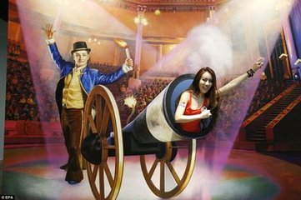
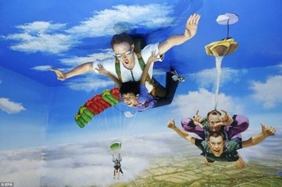
more amazing 3-D pictures

Slide 17
Useful expressions to talk about news:
1)Do you know about…?
2)I heard of/read about/learnt about….
3)That’s really cool/amazing/wonderful
/strange/interesting/great/funny.
4)Do you know any amazing/wonderful/
strange/interesting/great/funny things?
5)You won’t believe it, but I read about….
6)You must be kidding.
7)What happened?

Slide 18
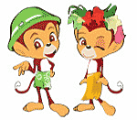
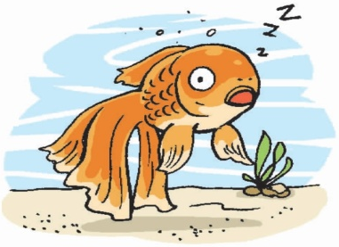
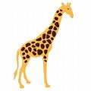
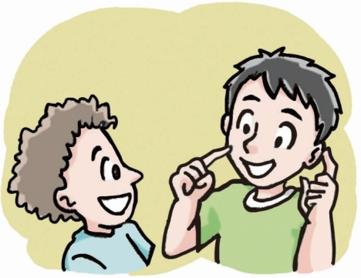
Role Play
Work in groups and talk about some amazing things you know and act them out.
A: Do you know anything amazing about…?
B: …
A: That’s interesting! …
B: …
…

Slide 19

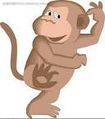
Example:
That’s interesting! What funny things do you know?
Fish can sleep with their eyes open.
Do you know anything amazing about giraffes?
Yes. I know a giraffe has only seven bones in its long neck. Isn’t it surprising?

Slide 20

What can you learn from
this lesson?
1. Do more reading, and you’ll learn
lots of amazing things.
2. Everyone has some amazing experiences.
Love life. Love nature.

Slide 21
Language points
Camels can live without water for a long time.
介词without意为“没有”，它与后面所接的名词、代词或V-ing等共同构成介词短语，在句中作状语。
①Most plants can’t grow without sunshine.
大多数植物没有阳光就不能生长。
②I can’t live happily without her.
没有她，我不可能快乐地生活。
③I went to school without eating breakfast.
我没吃早饭就去上学了。

Slide 22

Surf the Internet for more amazing
things.
2. Finish the exercises in Learning
English.
3. Preview Study skills on page 65.
4. Preview Task on pages 66-67.

